Slide 1
Predicting an NBA Player’s Likelihood of Success
Justin Faraday Jacob Sun

Slide 2
Project Overview
Our goal was to discover stats/combinations of stats that could reliably point to whether a player would become an all-star level player
To do so we used a dataset of the stats of every year of every NBA player’s career combined with a list of the winners of every major award

Slide 3
Data
Player statistics were pulled from the NBA.com API using https://github.com/swar/nba_api
Data on awards were pulled from basketball-reference.com and included:
All MVP winners
All Rookie of the Year winners
All Defensive Player of the Year winners
All 6th Man of the Year winners
All Most-Improved Player winners
All All-NBA Teams
All All-Defense Teams
All All-Rookie Teams

Slide 4
Preprocessing (Predictions for AllRookie)
Split into numerical and categorical attributes
MinMaxScaler, OneHotEncoder, SimpleInputer are used to scale data and fill the empty cells if any
Pipeline them and perform fit_transform()
Data is ready for decision tree models

Slide 5
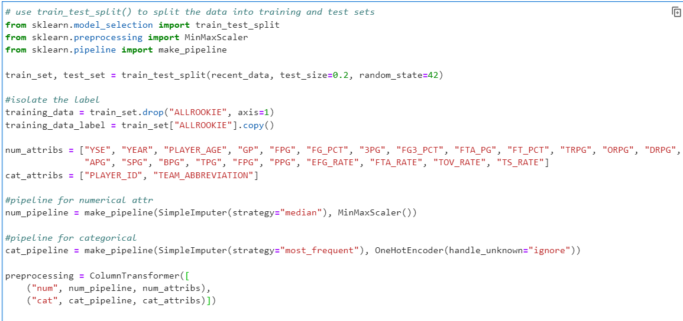

Slide 6


Decision Tree
Decision Tree Regressor
Random Forest Regressor

Slide 7


Evaluate and Choose a Model
Compare the value of RMSE
Random Forest Regressor is chosen (smaller RMSE value)

Slide 8
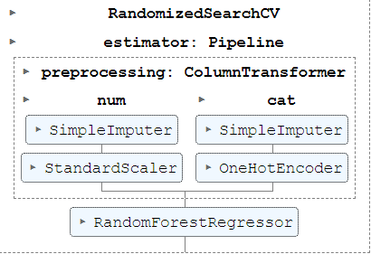
Fine Tune the model
Pipeline Preprocessing and Random Forest Regressor
Apply Randomized Search

Slide 9
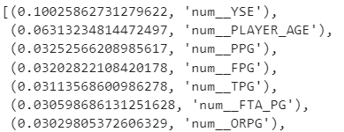
Determine the importance of features

Slide 10
Repeat the process for other predictions
ALLSTAR
ALLNBA
ALLDEF

Slide 11
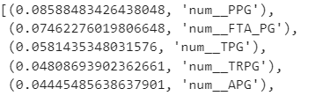
Important Features for ALLSTAR

Slide 12
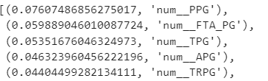
Important Features for ALLNBA

Slide 13
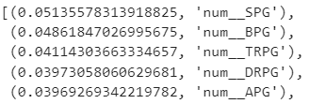
Important Features for ALLDEF

Slide 14
Possible Correlation
PPG, FTA_PG, and TPG are important for determining non-ALLDEF.
APG is important for ALLDEF, ALLNBA, and ALLSTAR.
Confirm it with correlation table

Slide 15
